Slide 1



Symptoms
Fever greater than 100.4
Cough
Shortness of breath
Fatigue
Muscle aches
Headache
Loss of taste/smell (can last for weeks or months)
Sore throat
Congestion/runny nose
Nausea
Vomiting
Diarrhea
** Delta Variant is more than two times as contagious as previous variants.
This Photo by Unknown Author is licensed under CC BY-ND

Slide 2
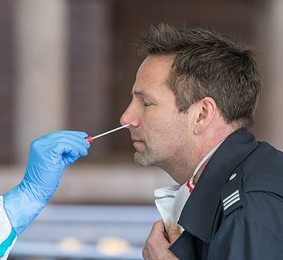
Vaccinated: 3-5 days after exposure, even if you’re not showing symptoms
Unvaccinated: 5-7 days after exposure
PCR Testing:
  LHI tent behind the health department
  Tuesday – friday: 8am – 3pm
  Saturday: 10AM – 2PM
  Closed on Mondays
  No appointment needed
  Takes 24-48 hours for results
  Test is more sensitive and accurate
Rapid Antigen Testing:
  health department for county employees only
  Goshen Medical Center in Raeford for everyone else
  Pull around to the back of the health department
  Takes less than 15 minutes for results
  A need to know right now
Testing
** If you have a rapid test completed and results are negative, but you’re having symptoms, we highly recommend to follow up with a PCR test.
This Photo by Unknown Author is licensed under CC BY-SA

Slide 3
Outbreak vs cluster
2 or more positive results
Congregate living
  Jails
  Nursing homes
  Retirement homes
5 or more positive results
Factory/Plants
Educational setting
  schools
  Daycares

Slide 4
When to Quarantine?
Having close contact with someone who tested positive
Close contact = being less than 6 feet from someone for 15 minutes or more
Vaccinated = only if having symptoms
unvaccinated = 14 days at home
Quarantine can end early!
  Day 10 – without testing AND have no symptoms
  Day 7 – with a negative test AND have no symptoms
  Continue to monitor symptoms through day 14 and wear a mask in public and indoors

Slide 5
Quarantine (household)
Quarantine if you are a close contact of someone testing positive
Quarantine begins on last day of exposure to the family member that tested positive
Try to separate and stay separated in the household for the time period
If separation cannot happen, everyone will be quarantined together per CDC guidelines for vaccinated/unvaccinated members
School age siblings will quarantine at the same time Per CDC guidelines
Example:
Husband
Tested positive on 9/1/21
Husband
Unvaccinated, isolates for 14 days, ending on 9/15/21
Wife
Last day of exposure: 9/2/21, quarantine started
Unvaccinated, quarantine ends 9/16/21

Slide 6
Child care, school, after school care
Child care quarantine
  Who: non-school age children
  Time: 14 days
  Why: due to the younger children not adhering to non-pharmaceutical prevention (i.e. wearing a mask) as well as older children
School
  Who: K-12 grades
  Time: 10 days
  Why: due to children sitting 3 feet apart inside the classroom and symptoms will begin to show between 3-5 days
Closing of classrooms is the school or facility director’s decision
  Thorough cleaning/disinfecting is highly recommended daily

Slide 7
When to isolate/going back to activities?
Isolate: When you test positive
Stay separated from those you live with
Isolate for 14 days
Or
10 days since first symptom appeared
AND
Must be fever free without the use of fever reducing medications for 24 hours
AND
Symptoms are improving

Slide 8
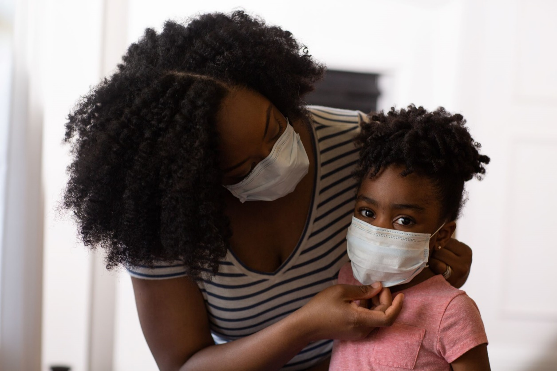
Preventing the spread of COVID
If you’re sick, stay at home, except to get medical care
call ahead before visiting the doctor
Separate yourself from others
Monitor symptoms
Get tested
Wear your mask over your nose and mouth
Cover coughs/sneezes with a tissue and throw tissue away
Wash hands often
Avoid sharing personal items
Clean all surfaces daily
Social distance – 6 feet away
Avoid crowds
vaccinate
This Photo by Unknown Author is licensed under CC BY-ND

Slide 9
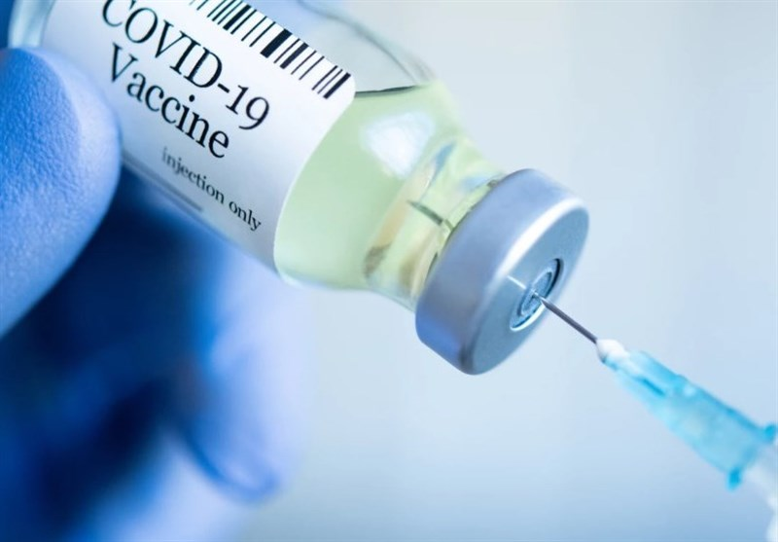
Vaccines
Vaccination reduces the risk of getting and spreading covid-19 and getting seriously ill if you do get COVID-19.
Vaccinating may protect the people around you, especially those around you that cannot get vaccinated.
Vaccines are for ages 12 and older. 12-17 year old will get the Pfizer. Parental Consent needed for ages 12-15.
COVID vaccines are free and available just about anywhere.
Most COVID cases are in people who are not fully vaccinated.
The body generally takes 2 weeks after vaccinating to build protection against the virus.
Booster doses are still in the process of being FDA approved.
Priority booster dosing: healthcare workers, first responders, congregate living facilities, immunocompromised, immunosuppressed, and elderly.
Normal Side effects from the vaccine: headache, tired, fever/chills, sore arm
This Photo by Unknown Author is licensed under CC BY

Slide 10
Reporting
Fax or email positive lab results with patient’s name, date of birth, race, ethnicity, address, and phone number to Melinda (hoke county health department communicable disease RN) at 910-875-5731, covidreporting@hokehealth.org.
Call Hoke County Health Department to report an outbreak or cluster.

Slide 11
Resources
*All information regarding COVID in this presentation came from www.cdc.gov*
Cleaning and disinfecting: https://www.cdc.gov/coronavirus/2019-ncov/community/disinfecting-building-facility.html
School and Child care: https://www.cdc.gov/coronavirus/2019-ncov/community/schools-childcare/index.html
ChildCare Strong NC Public Health Toolkit: https://covid19.ncdhhs.gov/media/220/download?attachment
StrongschoolsNC Public Health Toolkit: https://covid19.ncdhhs.gov/media/164/open

